Slide 1
DCA RWY 19
Minimum Cloud Height on Approach

Slide 2
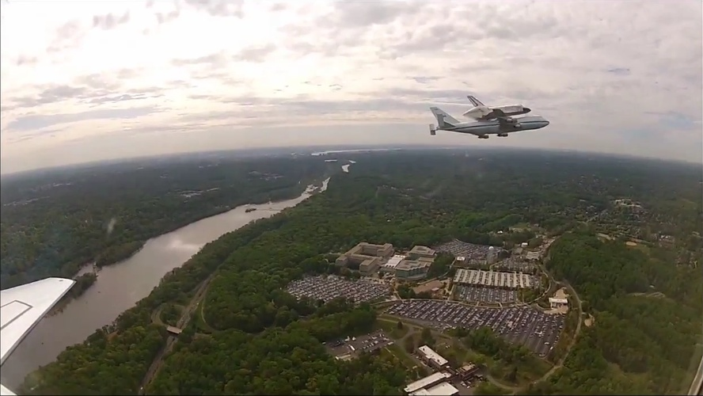
Crossing Altitude on Approach at DARIC will be 2,700 ft. Cloud height determines which approach aircraft fly
River Visual (100%)* No minimums 3 miles visibility 3,500 ft. min. cloud height
RNAV GPS (95%)* 767 ft. min. 2 ½ miles visibility 800 ft.cloud height
LDA-Z (100%)* 720 ft. min. 2 miles visibility 800 ft. cloud height
RNAV RNP (50%) * 478 ft. min. 1 ½ miles visibility 500 ft. cloud height
*Percentage of aircraft capable of flying this type of approach.

